Slide 1
CSET301 – AI-ML
Lecture 23 : K-means Clustering

Slide 2
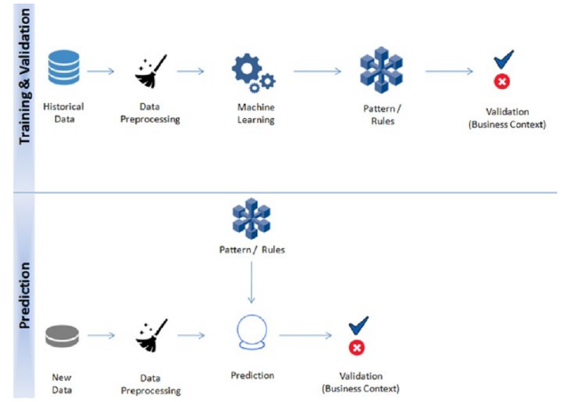
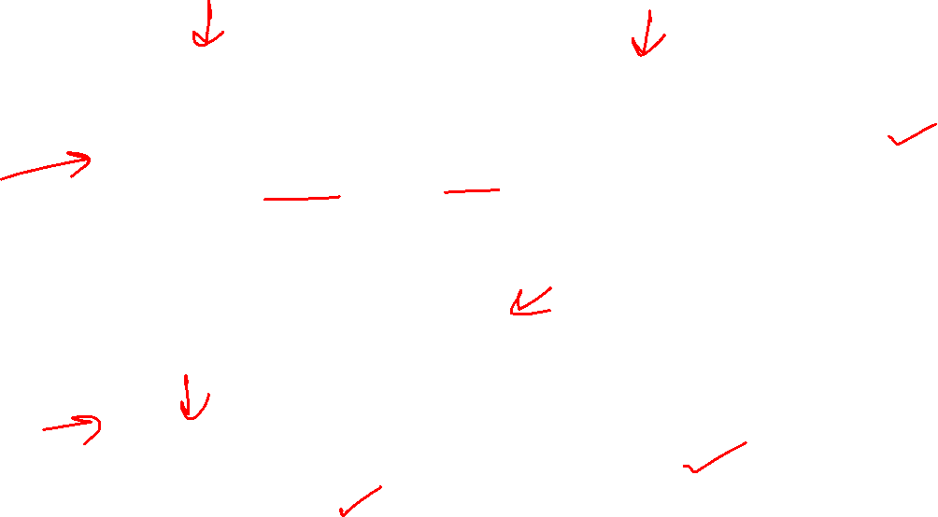
Unsupervised Learning Flow

Slide 3
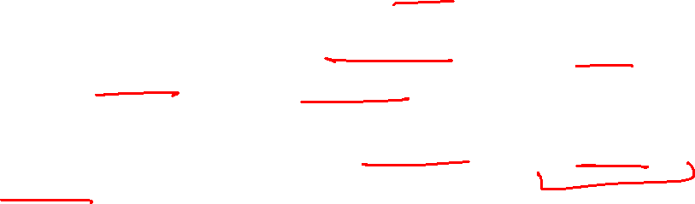
Clustering
Clustering is an unsupervised learning problem.
• Key objective is to identify distinct groups (called clusters) based on some notion of similarity within a given dataset.
• The most popularly used clustering techniques are k-means (divisive) and hierarchical (agglomerative).

Slide 4
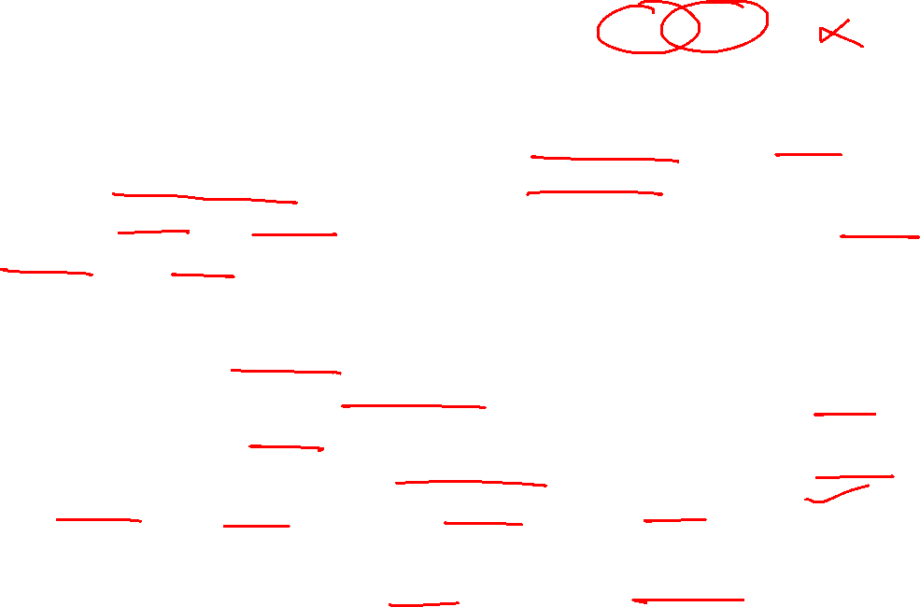
K-means Clustering
• The key objective of a k-means algorithm is to organize data into clusters such that there is high intra-cluster similarity and low inter-cluster similarity. An item will only belong to one cluster, not several, that is, it generates a specific number of disjoint, non-hierarchical clusters.
• K-means uses the strategy of divide and concur, and it is a classic example for an expectation maximization (EM) algorithm. EM algorithms are made up of two steps:
  – The first step is known as expectation(E) and is used to find the expected
  point associated with a cluster; and
  – The second step is known as maximization(M) and is used to improve the
  estimation of the cluster using knowledge from the first step.
• The two steps are processed repeatedly until convergence is reached.

Slide 5
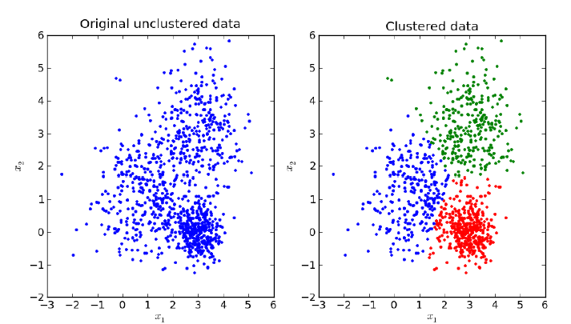
K-means Clustering

Slide 6
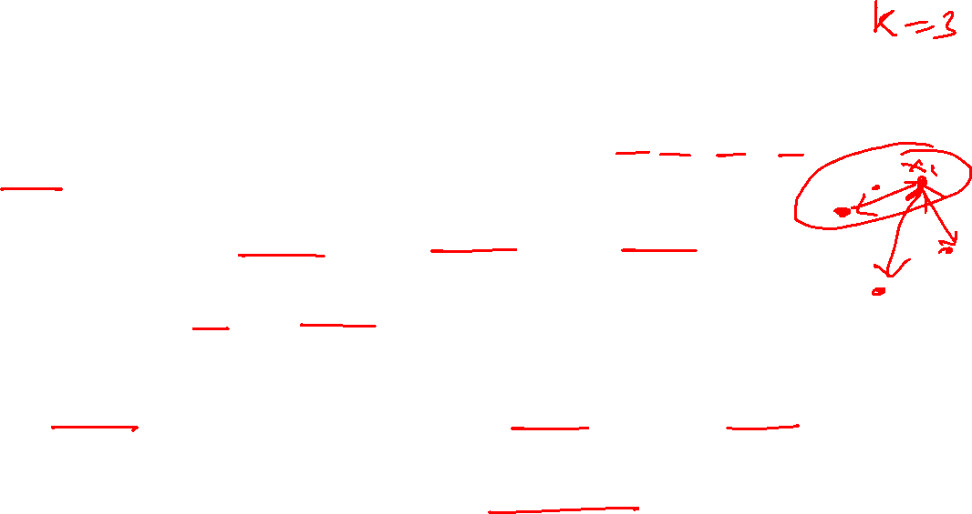
K-means Clustering Algorithm
Our algorithm works as follows, assuming we have inputs x₁, x₂, x₃,…,x_{n} and value of K
– Step 1 - Pick K random points as cluster centers called centroids.
– Step 2 - Assign each x_{i} to nearest cluster by calculating its distance to each centroid.
– Step 3 - Find new cluster center by taking the average of the assigned points.
– Step 4 - Repeat Step 2 and 3 until none of the cluster assignments change.

Slide 7

Algorithm Work-Flow
Step 1: In the first step k centroids is randomly picked (only in the first iteration) and all the points that are nearest to each centroid point are assigned to that specific cluster. Centroid is the arithmetic mean or average position of all the points.
Step 2: Here the centroid point is recalculated using the average of the coordinates of all the points in that cluster. Then step one is repeated (assign nearest point) until the clusters converge.

Slide 8
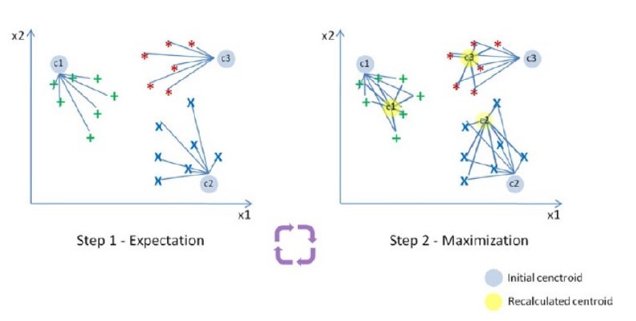

Algorithm Work Flow

Slide 9
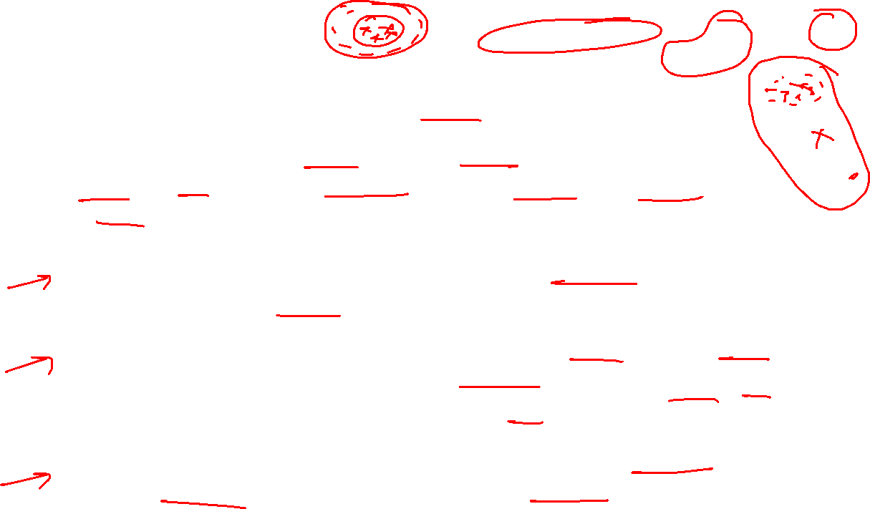
Limitations
Need to specify the number of clusters (k) in advance.
Assumes clusters are spherical and equally sized: Work best when clusters are compact, convex and roughly equal in size. Struggles with clusters of different shapes (e.g., concentric circles) or densities.
Sensitive to outliers and noise: Outliers can drastically shift the centroid, leading to poor clustering results.
Only works with numeric data: Relies on computing means and Euclidean distances, so it cannot directly handle categorical features (like gender, city, etc.) without preprocessing or using variants (e.g., k-modes).
Distance-based, so scaling matters: Features with larger numeric ranges dominate the distance metric, so data must be standardized/normalized first.

Slide 10
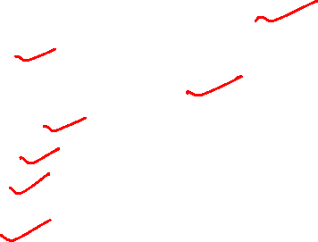
Use Cases
K-Means is widely used for many applications.
  – Image Segmentation
  – Clustering Gene Segmentation Data
  – News Article Clustering
  – Clustering Languages
  – Species Clustering
  – Anomaly Detection

Slide 11
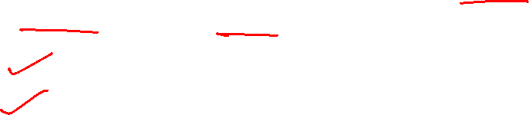
How many clusters?
There are two commonly used methods to determine the ideal number of clusters possible in K-means:
  – Elbow Method
  – Silhouette Method

Slide 12
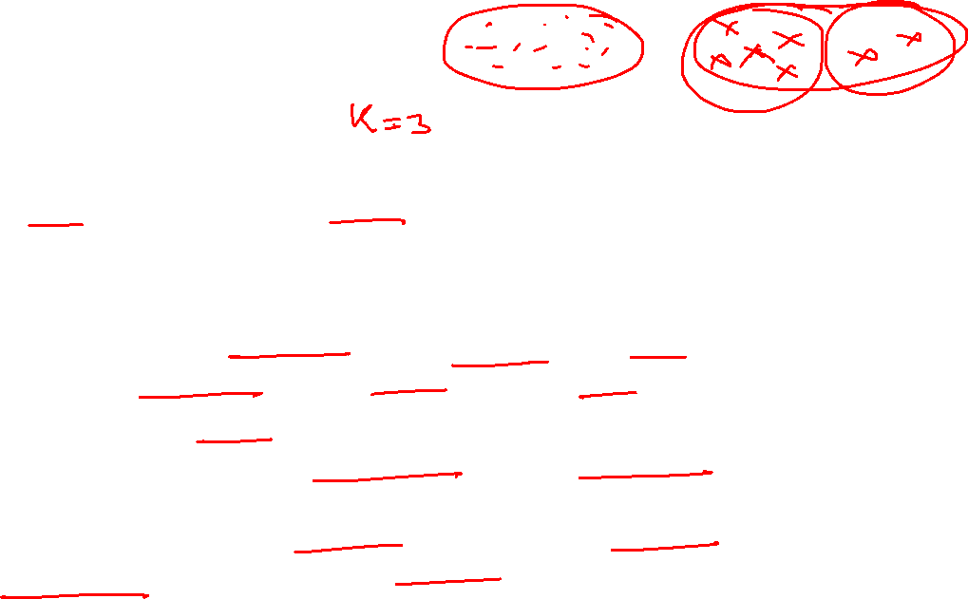
Elbow Method
The Elbow Method is a commonly used technique to determine the optimal number of clusters (k) in clustering algorithms like k-means.
Intuition
As we increase the number of clusters k, the within-cluster variation (WCSS) — i.e., how spread out points are within each cluster — decreases because clusters get smaller and more specific.
But after a certain point, adding more clusters gives diminishing returns (only small improvements).
The “elbow point” on the curve of WCSS vs. k indicates a good balance between cluster compactness and number of clusters.

Slide 13

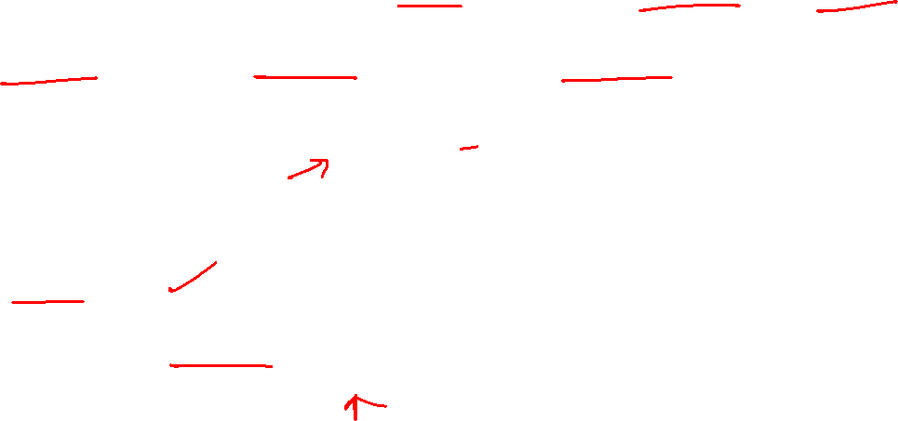
Elbow Method
Steps
Run the clustering algorithm (e.g., k-means) for a range of k values (say 1–10).
For each k, compute the WCSS (Within-Cluster Sum of Squares):
where C_{i}​ is cluster i and μi​ is its centroid.
Plot WCSS vs. k.
4. Look for the “elbow” point where the rate of decrease sharply slows down — that k is the optimal number of clusters.

Slide 14
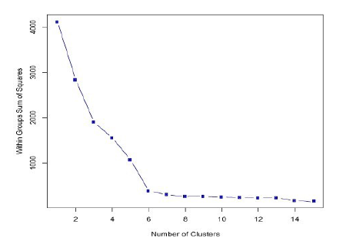
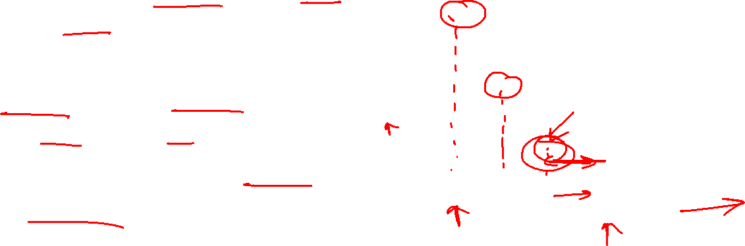
Elbow Method
Interpretation
Before elbow → WCSS decreases steeply (adding clusters significantly improves fit).
At elbow → Best trade-off between accuracy and simplicity.
After elbow → WCSS decreases slowly (extra clusters don’t add much value).

Slide 15

Silhouette Method
The Silhouette Method is a technique used to evaluate the quality of clustering in unsupervised learning (e.g., k-means, hierarchical clustering).
It helps determine how well data points are assigned to their clusters and can also guide the choice of the optimal number of clusters.
Intuition
For each data point i:
Compute cohesion: how similar it is to points in its own cluster.
Compute separation: how different it is from points in the nearest other cluster.
The Silhouette score compares these two measures.

Slide 16

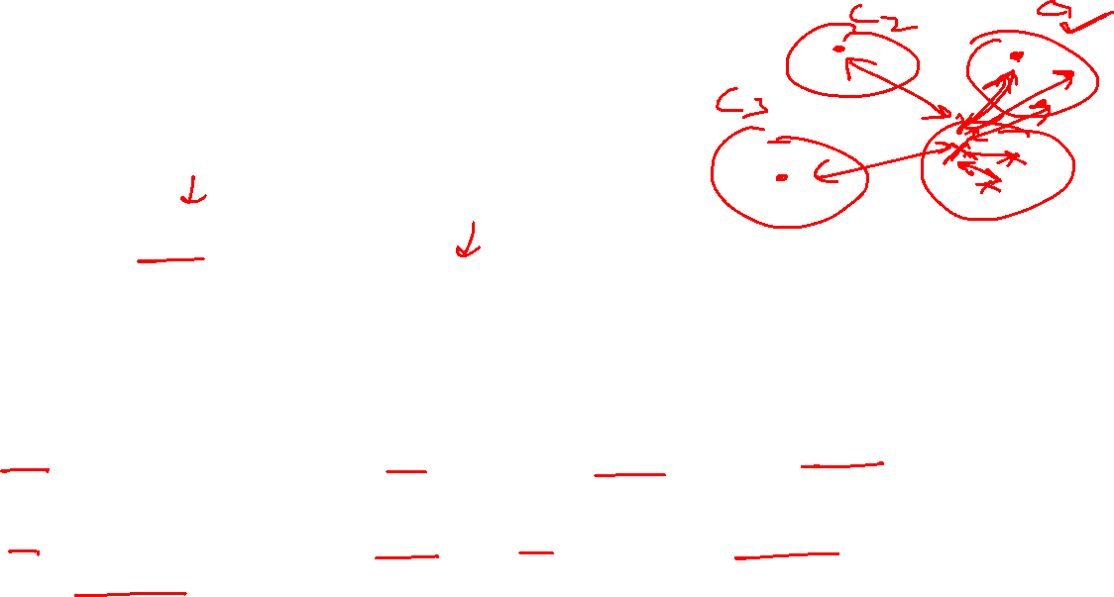
Silhouette Method
Formula
For a data point i:
where:
a(i) = average distance of point i to all other points in the same cluster (intra-cluster distance).
b(i) = minimum average distance of point i to points in any other cluster (nearest-cluster distance).

Slide 17

Silhouette Method
Interpretation
s(i) ranges between –1 and +1:
  Close to +1 → point is well clustered (good fit).
  Around 0 → point lies on the boundary between clusters.
  Negative (< 0) → point is probably in the wrong cluster.
The overall silhouette score is the average s(i) across all points.

Slide 18
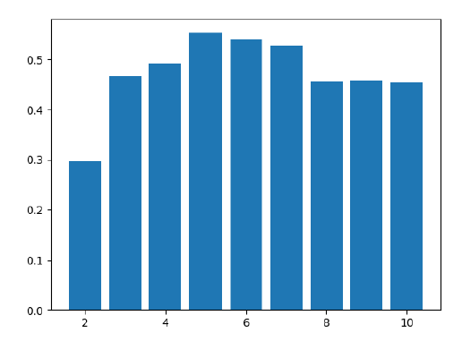
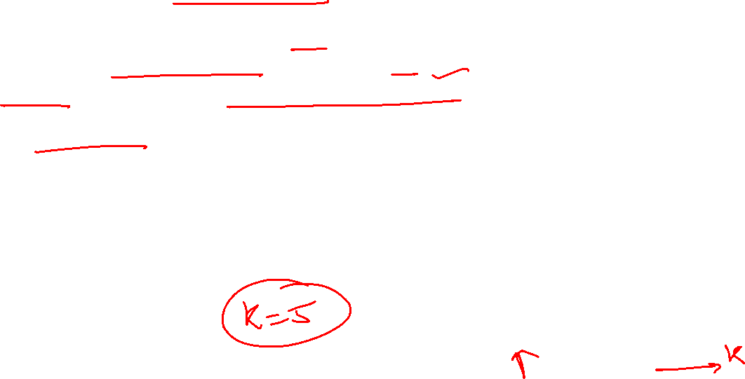
Silhouette Method
Using it for Choosing Number of Clusters (k)
Run clustering for different values of k.
Compute the average silhouette score for each k.
The best k is the one that maximizes the silhouette score (or gives a good balance of high score and interpretability).

Slide 19
Thank You

